Slide 1


The Custom Batch Exercise
January 7, 2015
Presenters name, Title - Date

Slide 2
What we are doing this morning
We will have a review of the great work you folks did yesterday.
We will look at a couple of solutions (volunteers, I won’t make anyone present who doesn’t want too.)
We will go back to the stock Custom batch and build and run the solution. This will give you some hands on time.
Then it is on to XCOM extensions.

Slide 3
Doing the Lab
January 5, 2015

Slide 4
Step 1
Make sure your VM is shut down.
I am going to send you a zip file with the code in it.
You need to create a folder (I called mine Projects) and extract the zip file into it.
You should have a VS project in the folder.

Slide 5
Step 2
You now need to move the project to your virtual machine. So:
Open Player.
Select (single click so you don’t start it) the virtual machine.
On the right hand side, chose “edit virtual machine settings”

Slide 6
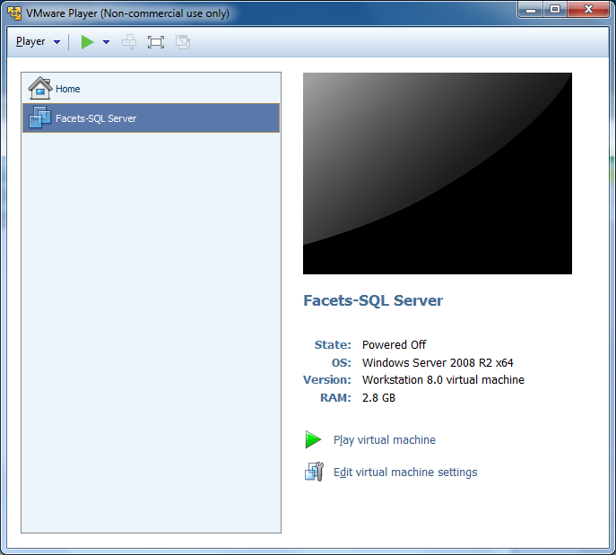
Step 2 – what you will see.

Slide 7
Step 3
Click on edit virtual machine settings to bring up the following screen.

Slide 8
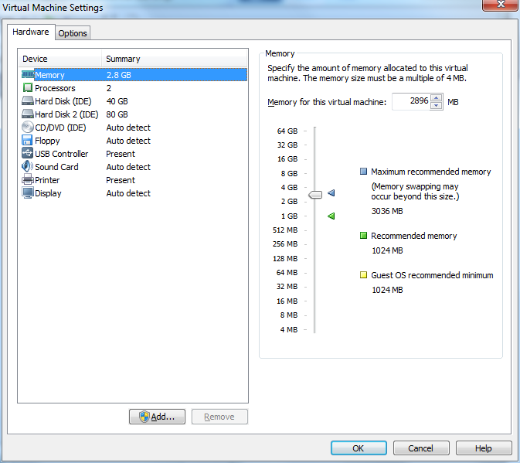
Step 3A – what you will see.

Slide 9
Step 4
Check the memory allocation. I have found that a value slightly below the recommended maximum gives me the best performance.
Next chose the Options tab on the left. This will bring up the following screen.

Slide 10
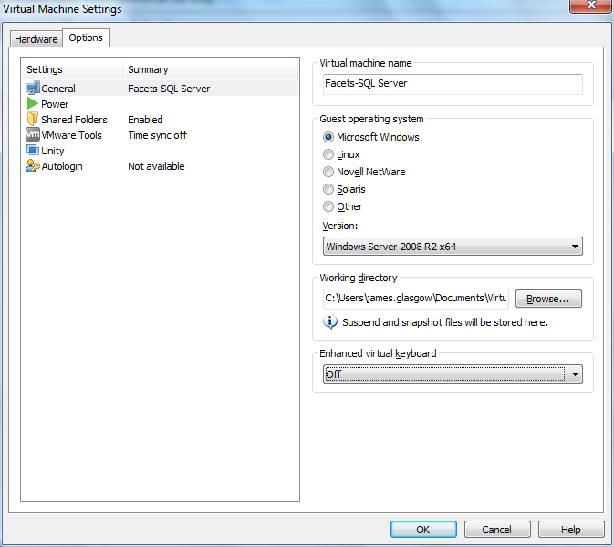
Step 4A – what you will see.

Slide 11
Step 5
We now need to make the folder you created back at the start accessible to your virtual machine.
Chose the Shared Folder option from the left. This will bring up the following screen.

Slide 12
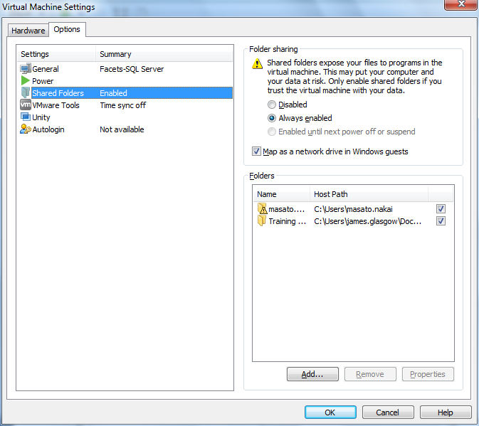
Step 4A – what you will see.

Slide 13
Step 6
Add the folder that you set up previously to the list in the panel. (Note that what you see may be different from what’s on my screen.)
Click on add to bring up the dialog box.

Slide 14
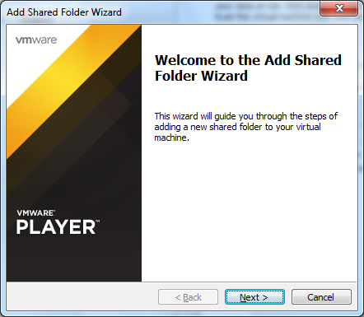
Step 7 – what you will see.

Slide 15
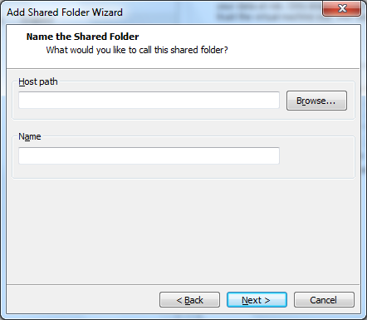
Step 8 – what you will see.
Click the browse button to bring up the standard file search dialog.

Slide 16
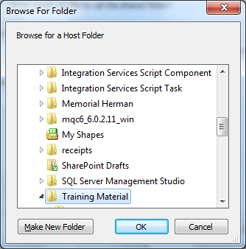
Step 9 – what you will see.
And select OK

Slide 17
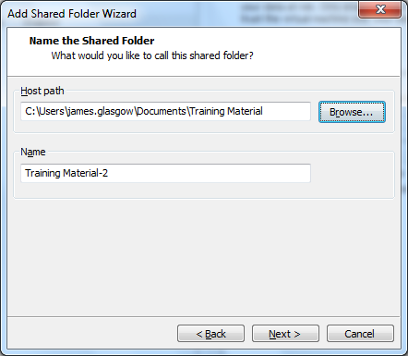
Step 10 – what you will see.
Choose next

Slide 18
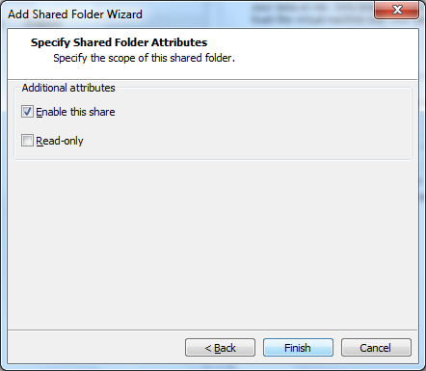
Step 11 – what you will see.
Make sure that enable this share is selected, and click finish.

Slide 19
Q & A
January 15, 2015

